Slide 1
Humpback Whales Identification
` By
Emily Medema
Stephen McKeon
Flourish Adebayo

Slide 2
Outline
Introduction
Methodology
CNN Model
Transfer Learning Model
SVM Model
Results
Conclusion
References

Slide 3
Introduction
The humpback whales is a species of baleen whales, it has a distinctive body shape with long fines and knobbly head.
At the beginning of the 20th century whales population dropped but increased briefly in the mid -20th century due to the creation of international whaling committee and their preservation efforts.
Features such as the whales tail, marking, shape help researchers to identify the type of whale they are analyzing.
Deep Learning neural networks are presently the main tool used for image analysis and classification purposes.
Notes:
Flourish

Slide 4
Review of Related works
Author(s) | Title | Model | Accuracy
He et al., 2016 | Deep residual learning for image recognition | ResNet | 80%
Zhang et al., 2006 | SVM-KN: Discriminative nearest neighbor classification for visual category recognition | SVM KNN | 85%
Brust et al., 2017 | Towards automated visual monitoring of individual gorillas in the wild | SVM | 62.40%
Yuan et al., 2020 | Aquatic animal image classification technology based on transfer learning | Transfer Learning | 89.10%
Bergamini et al., 2018 | Multi-views embedding for re-identification | KNN | 81.70%
Freytag et al.,2016 | Chimpanzee faces in the wild | Log Euclidean CNN | 90%
Notes:
I don’t think we need this slide for the presentation as we are mainly showing our results. - Emily

Slide 5
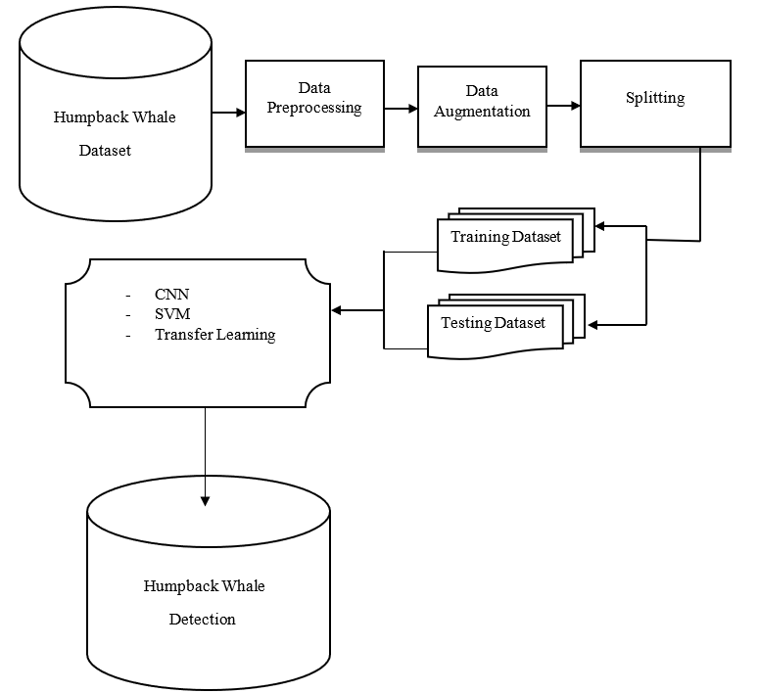
Architecture
Figure 1: Architecture Diagram of Humpback whales identification
Notes:
Flourish

Slide 6
Methodology
Dataset description: The Humpback whale Identification datasets contains thousand images in which 25,361 images (76.11% ) was used for training and 7,960 (23.89%) for testing.
Data Preprocessing: Preprocessing was conducted to remove noise and crop to show only the fluke.
Dataset Augmentation: Augmentation such as filipping, rotating and scaling of images was done to increase dataset size and reduce overfitting.
Model(s): CNN, transfer learning and SVM
Notes:
Steve
~5 minutes

Slide 7
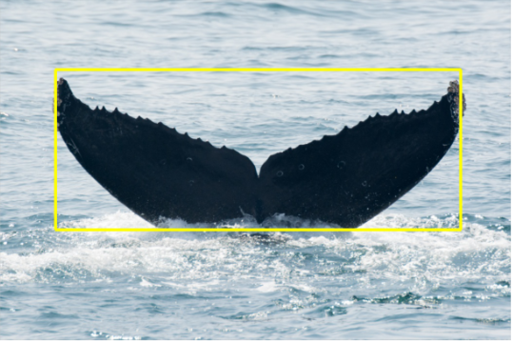
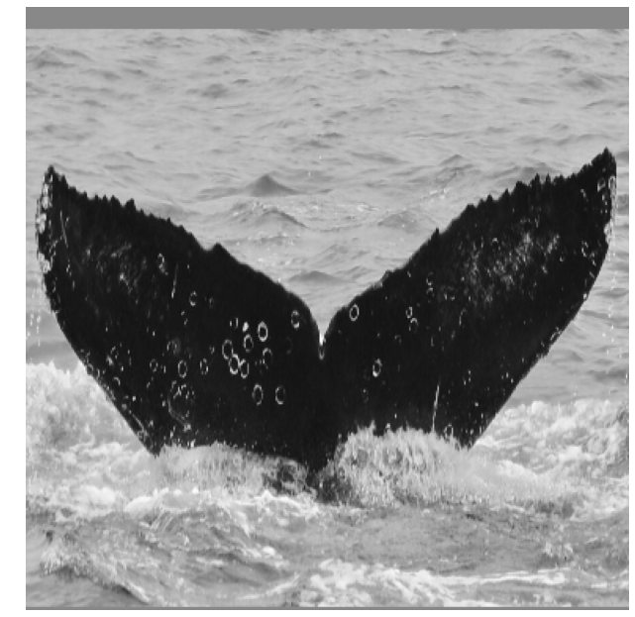
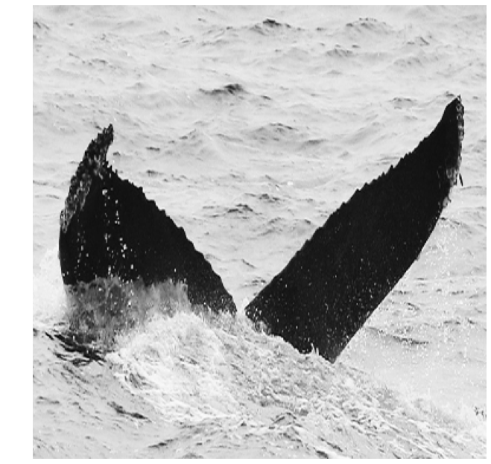
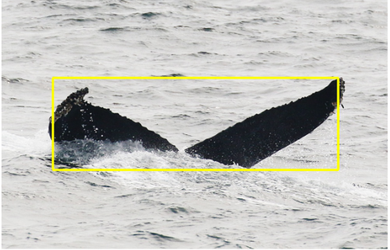
Notes:
Steve
Varying input image size and colour, to uniform 384x384 greyscale.
Had to pad a small border to the bounding box to ensure every fluke was captured in the crop.

Slide 8
Model 1 - CNN
Model training and testing: CNN using python library keras model was utilized as the first model. Data was formatted for use in model.
Padding was set to “same”.
Max pooling was utilized on the model.
Batch Normalization and Dropout was utilized in other to prevent overfitting.
Adam Optimizer was used to optimize the gradient descent of the model.
Notes:
Emily

Slide 9
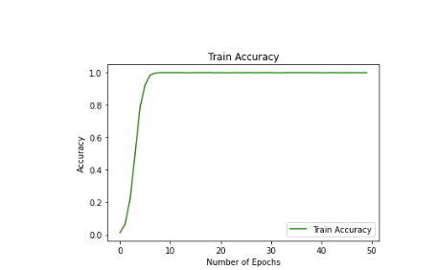
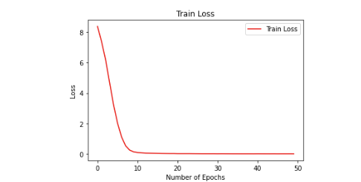
Model 1 - CNN Proof of Concept
Figure 2a: Training accuracy on 10% of Training Data
Figure 2b: Training loss on 10% of Training Data
Notes:
Emily
10% of the data was trained to know if the architecture will work for the model. The model overfits onto this subset of data.

Slide 10
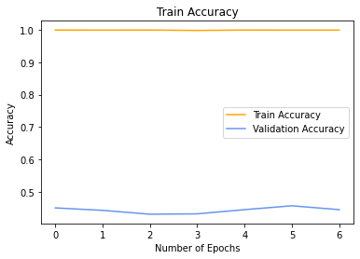
Model 1 - CNN Tuning
With Proof of Concept, we expanded to the rest of the dataset but it was overfitting onto the training set.
Notes:
Emily
Now that we know that a CNN model like this works for our data, we trained it on a larger subset of the data, specifically all data where there are 5 or more images of a specific whale. We then
split the data into training and validation sets.

Slide 11
Model 1 - CNN Tuning
We tested the following hyperparameters:
Activation Functions (relu vs. tanh)
Dense Layer Units
Number of Dropout Layers and Rates
L2 regularization and rates
Data Augmentation
Notes:
Emily

Slide 12
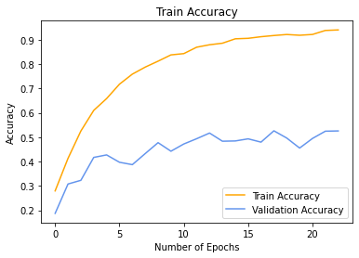
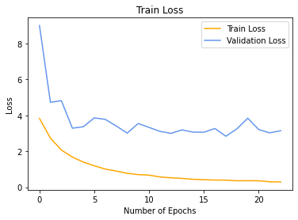
Model 1 - CNN Results
Notes:
Emily

Slide 13
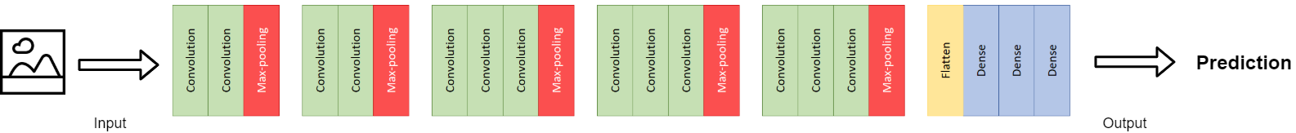
Model 2 - Transfer Learning
Notes:
Steve

Slide 14
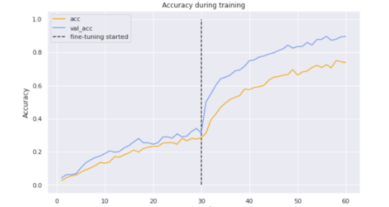
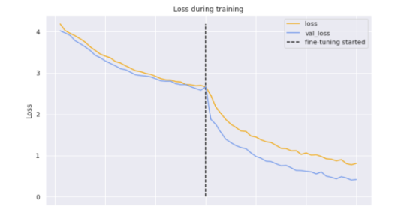
Model 2 - Transfer Learning
Figure 3a: Transfer Learning with VGG16_20+ - Accuracy
Figure 3b: Transfer Learning with VGG16_20+ - Loss
Notes:
Steve

Slide 15
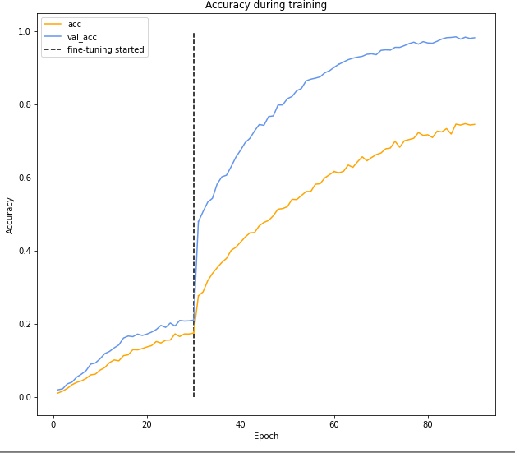
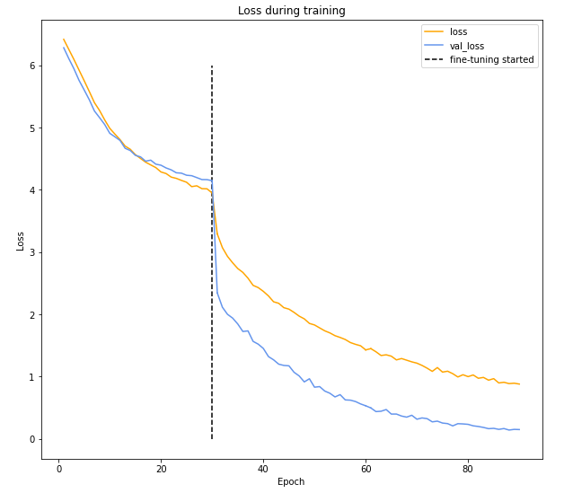
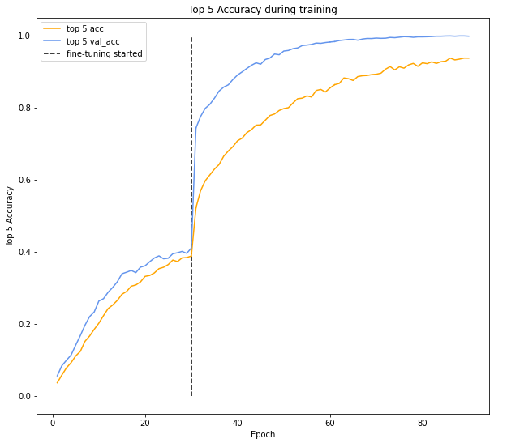
Model 2 - Transfer Learning
Figure 3c: Transfer Learning with VGG16_20+ - Accuracy
Figure 3d: Transfer Learning with VGG16_20+ - Loss
Figure 3e: Transfer Learning with VGG16_20+ - Top 5 Accuracy
Notes:
Steve
~5 minutes
VGG16 is object detection and classification algorithm which is able to classify 1000 images of 1000 different categories with 92.7% accuracy (top-5 on ImageNet). This is with 633 classes, though I imagine it would perform very poorly against the total 5000+ classes in the original dataset - unable to store that in memory to try, however.

Slide 16
Model 3 - SVM
We also wanted to test a more basic model against the two more complex models as a baseline. The model used:
Multi-class Classification
Softmax activation and Squared Hinge Loss
L2 Regularization
As expected, it did not perform well having a very low validation accuracy.
Notes:
Flourish

Slide 17
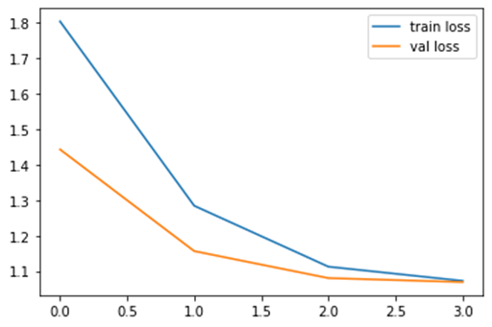
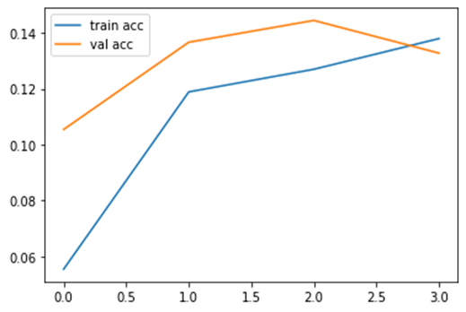
Model 3 - SVM contd.
Notes:
Flourish

Slide 18
Results
We attempt to use traditional methods such as SVM. It gave a very low validation accuracy
CNN and Transfer Learning perform well in the whale identification task while SVM is not suitable for the problem.
Transfer learning gave an accuracy of 98.18% (top-5 acc 99.8%) while Convolutional Neural Network gave 99% training and top-5 accuracy but only 41% validation accuracy (61% val top-5).
However, CNN is overfit on the training set so in the end Transfer Learning is the better model despite the close training accuracies.
Notes:
Emily

Slide 19
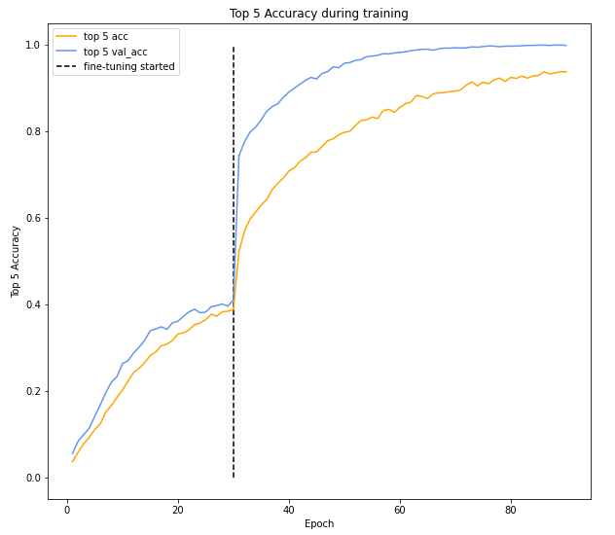
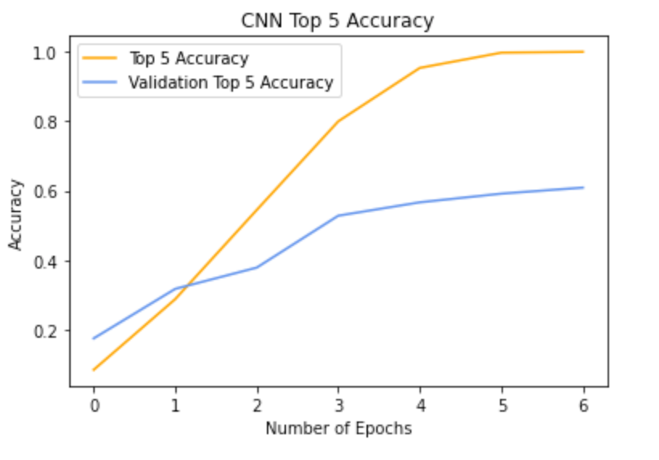
CNN and Transfer Learning Comparison

Slide 20
Conclusion
Architecture such as the Transfer Learning or CNN done in this project clearly works well for tasks such as this.
In the future it would be interesting to see You Only Look Once (YOLO) architecture be utilized which uses high dimensional features as input to a deep neural network.
Notes:
Emily

Slide 21
Selected References
A. Brust, T. Burghardt, M. Groenenberg, C. Kading, H. S. Kuhl, M. L. Manguette, and J. Denzler, “Towards automated visual monitoring of individual gorillas in the wild,” in Proceedings of the IEEE International Conference on Computer Vision Workshops, pp. 2820–2830, 2017.
A. Shukla, G. Sigh Cheema, P. Gao, S. Onda, D. Anshumaan, S. Anand, R. Farrell, et al., “A hybrid approach to tiger re-identification,” in Proceedings of the IEEE/CVF International Conference on Computer Vision Workshops, pp. 0–0, 2019.
L. Bergamini, A. Porrello, A. C. Dondona, E. Del Negro, M. Mattioli, N. D’alterio, and S. Calderara, “Multi-views embedding for cattle re-identification,” in 2018 14th international conference on signal-image technology & internet-based systems (SITIS), pp. 184–191, IEEE, 2018
H. Yuan, S. Zhang, E. Qin, and H. Zhou, “Aquatic animal image classification technology based on transfer learning and data augmentation,” Journal of coastal research, vol. 105, no. sp1, pp. 129–133, 2020

Slide 22
Thanks for Listening !!!

